Slide 1
Adversarial Machine Learning
Ankur Bapna Gavilan Galloway

Slide 2
Open Problems
Bounds on adversarial influence
Value of adversarial capabilities
Technologies for secure learning

Slide 3
Bounds on influence?
Effort needed for adversary to influence
Lower bounds on performance
Some systems harder to reverse engineer?

Slide 4
Value of adversarial influence?
Natural threat models and impact on learner
How much influence can the learner tolerate

Slide 5
Secure learners for security
Detecting malicious training instances
More resilient learners
Mixture of orthogonal experts

Slide 6
Case 1: Poisoning SVM
Good points
Theoretical guarantees
Optimally poisoning a SVM based classifier
Works for kernelized SVM
Not so good
Optimization problem - non-convex
Can’t be used for practical attacks
Verified on extremely small datasets

Slide 7
Formulation
Goal
Introduce single malicious sample in training set
Maximize validation error
Frame goal as an optimization problem
Algorithm
Start with a training sample
Solve locally using gradient ascent
Resulting gradient : function of inner product

Slide 8
Experiments
100 training, 500 validation samples
MNIST Dataset - binary classification
7 vs 1
9 vs 8
4 vs 0

Slide 9
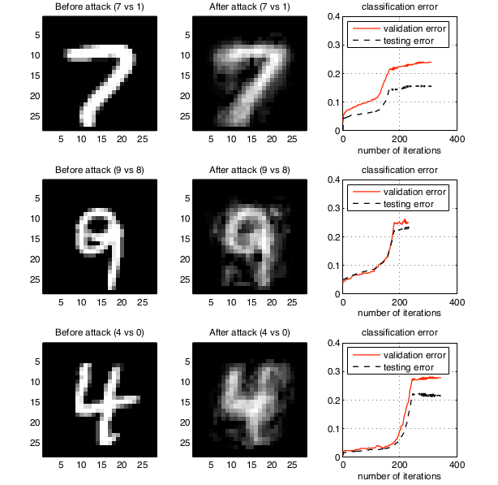

Slide 10
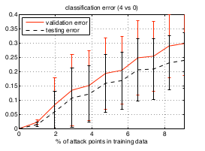
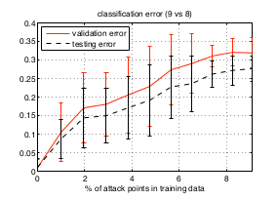
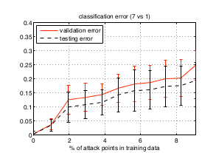
Performance

Slide 11
Result
Error rate ~ 2-5% for label flipping
Error rate ~ 15-20% for optimal poisoning

Slide 12
Possible improvements
Multi-point optimization
Less adversary control
Optimal label flipping for existing data point
Generating data point without label
More practical algorithm

Slide 13
Case 2: Poisoning resistant PCA
Evaluate existing algorithm with poisoning
Random poisoning
Informed poisoning (local and global)
Short term and boiling frog attacks
Improve performance - robust statistics
Resistant to boiling frog attacks
Still susceptible to random poisoning

Slide 14
Flow volume anomaly detection using PCA
Training
Y - cumulative traffic matrix containing time series for all network flows
Find principal components of Y
k components - maximum variance for training data
Model residual using Gaussian - find threshold t
Test
Variance not explained by top k components > t
Report anomaly

Slide 15
Poisoning
Random :
Add random traffic during training
Locally informed :
Information about current ingress traffic
Add traffic if current ingress traffic is large
Globally informed :
Omniscient, Omnipotent attacker
Add traffic optimally

Slide 16
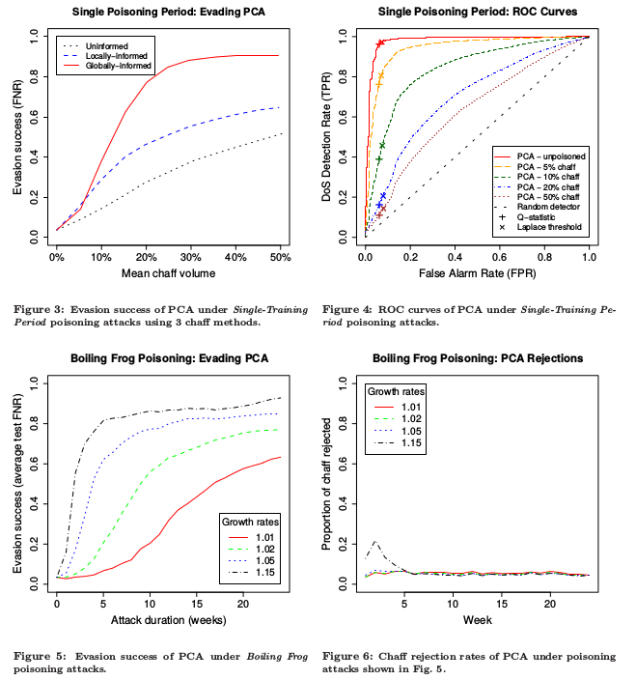
Performance of current system
Network information
advantageous
Boiling frog attack
more efficient
Need for more robust method

Slide 17
ANTIDOTE
Median instead of mean for centering
Median absolute deviation instead of variance
Evaluate Principal Components: PCA-GRID
Grid search algorithm
Use Laplace distribution to model residual

Slide 18
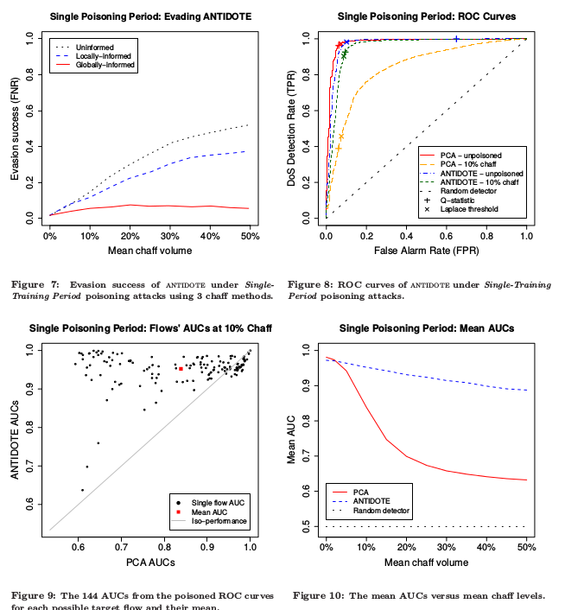
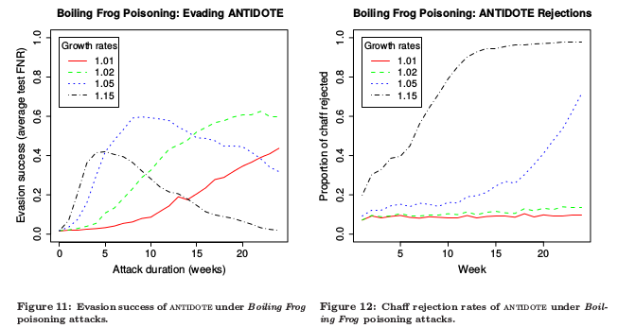
Performance of ANTIDOTE
More resistant to informed poisoning
More resistant to boiling frog attacks
Vulnerable to random poisoning

Slide 19
Thanks!!
Questions??

Slide 20
References
Open Problems in the Security of Learning, Tygar et. al.
Poisoning Attacks against Support Vector Machines, Biggio et. al.
ANTIDOTE: Understanding and Defending against Poisoning of Anomaly Detectors, Tygar et. al.

